Slide 1

Platform as a Service and Microsoft Azure Stack Hub
App Service Resource Provider in Microsoft Azure Stack Hub
This work is licensed under a Creative Commons Attribution - ShareAlike 4.0 International Public License

Slide 2
Agenda
What is App Service?
App Service on Azure Stack Hub
Architecture
Administration Scenarios
Developer Experience

Slide 3
What is App Service?

Slide 4


App Service on Azure Stack Hub
Web Apps
Azure Functions
API Apps
App Service on Azure Stack Hub
Provider experience
Fully managed platform
Enterprise-grade
Developer experience
Service configuration
Troubleshooting
Metrics
Auto scale
Framework patching
Load balancing
Languages and frameworks
Superior DevOps
Self-service supportability

Slide 5
App Service in Azure Public Cloud – Case Studies

Slide 6



Iberia Express
Objective
Scalable e-commerce website to sell flights, both through travel agencies and directly to consumers
Tactics
Built Azure App Service web app using Umbraco and SQL on Azure
Used VNet to connect data from on-premises
Result
Scalable website with integration for flight booking and check-in systems

Slide 7


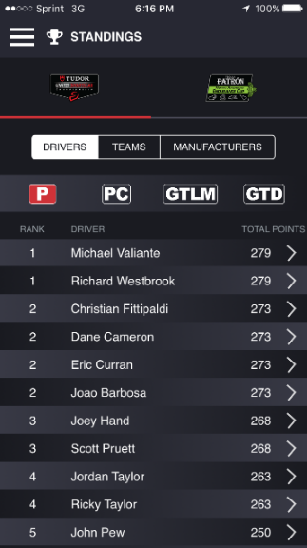
NASCAR
Objectives
Support live video with live timing and scoring
Custom (per-manufacture) experience
Support any device at large scale
Tactics
Using Azure Web App (running PHP) as front-end utilizing many Azure services such as Storage, SQL, Notification Hub, and Cache.
Incorporating Azure DevOps
Results
Highly scalable web and mobile solution support any device for streaming and live scoring
Engaging customers to interact with the application reaching millions of users

Slide 8
Azure App Service apps features and capabilities
Features in blue are available in Azure Stack Hub
Enterprise-grade apps
Designed for secure mission-critical applications
Fully managed platform
Optimized for availability and automatic scale
Built for DevOps
Agility through continuous deployment
Hybrid Connections / VPN Support
Scheduled Backup (to Azure Stack Hub or Azure storage)
Azure Active Directory Integration
Site Resiliency, HA, and DR
Web Jobs
Role-based Access Control
Enterprise Migration
Client Certs
Cache
IP Restrictions / SSL
Web Sockets
SQL, MySQL, DocDB, and Mongo
Sticky Sessions
Automated Deployment AutoScale
Built-in Load Balancing
WW Datacenter Coverage
End Point Monitoring and Alerts
App Gallery (gallery items must be marked as applicable to appear in Azure Stack Hub)
DR Site Support
WildCard Support
Dedicated IP address
HTTP Compression
CDN Support for Websites
Premium WordPress
App Services Environments
Site Staging Slots
Testing in Production
Continuous Integration / Deployment
Git, Visual Studio Online and GitHub
App and Site Diagnostics
OS and Framework Patching*
Site Extensions Gallery
NET, PHP, Python, Node, Java
Framework Installer (managed by Azure Stack Hub update process)
Browser-based editing
Auto-Healing
Logging and Auditing
Admin-site
Support Site Extension

Slide 9
App Service on Azure Stack Hub Overview

Slide 10

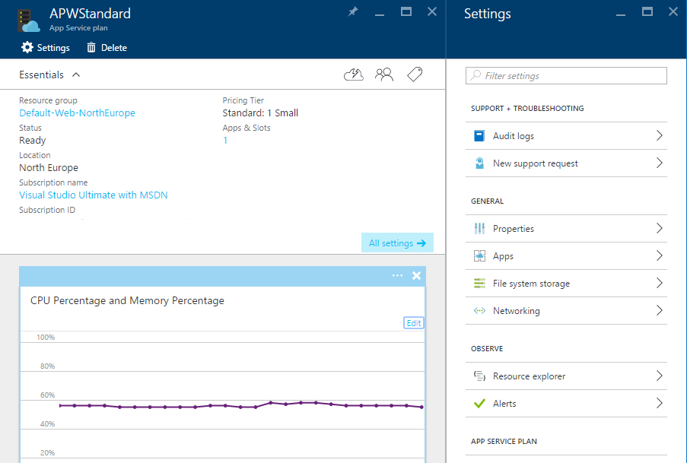
App Service plan
An App Service Plan (ASP) is a pricing container for applications
Each subscription can have multiple ASPs
Shared workers
High Density Multi-Tenant Apps
Only 1 tier enabled by default
You cannot have small, medium, and large (shared)
Dedicated workers
Used by only 1 tenant
Can be Small, Med, Large
Can define multiple sets
Cloud admin can create custom SKUs and worker tiers
https://docs.microsoft.com/en-us/azure/azure-stack/azure-stack-app-service-overview#what-is-an-app-service-plan

Slide 11
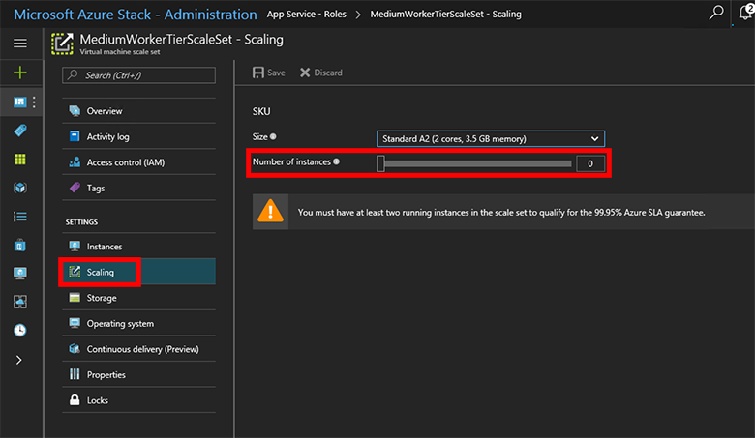
App Service concepts – Worker tier
Worker tier is a description for the Web Workers that host applications within App Service
In App Service on Azure Stack Hub, they can be customized for custom workloads
Scale up with Worker Tiers
Free and Shared Worker Tiers supported by default
To add additional tiers, add more worker roles
Adjust through increasing scale set instances

Slide 12
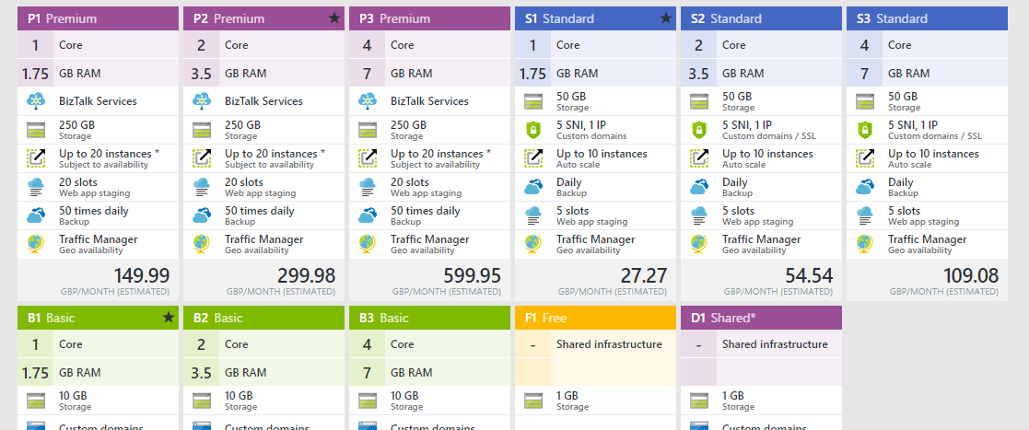
App Service concepts – SKU
Pricing structure
Fully customizable
Administrator defines pricing and feature set

Slide 13



Azure functions
Process events with serverless code
Make composing cloud apps insanely easy
Develop functions in C#, Node.js, F#, Python, PHP, Batch, and more
Easily schedule event-driven tasks across services
Expose functions as HTTP API endpoints
Scale functions based on customer demand
Easily integrate with Logic Apps
Code
Azure functions
Events + data

Slide 14
Architecture

Slide 15
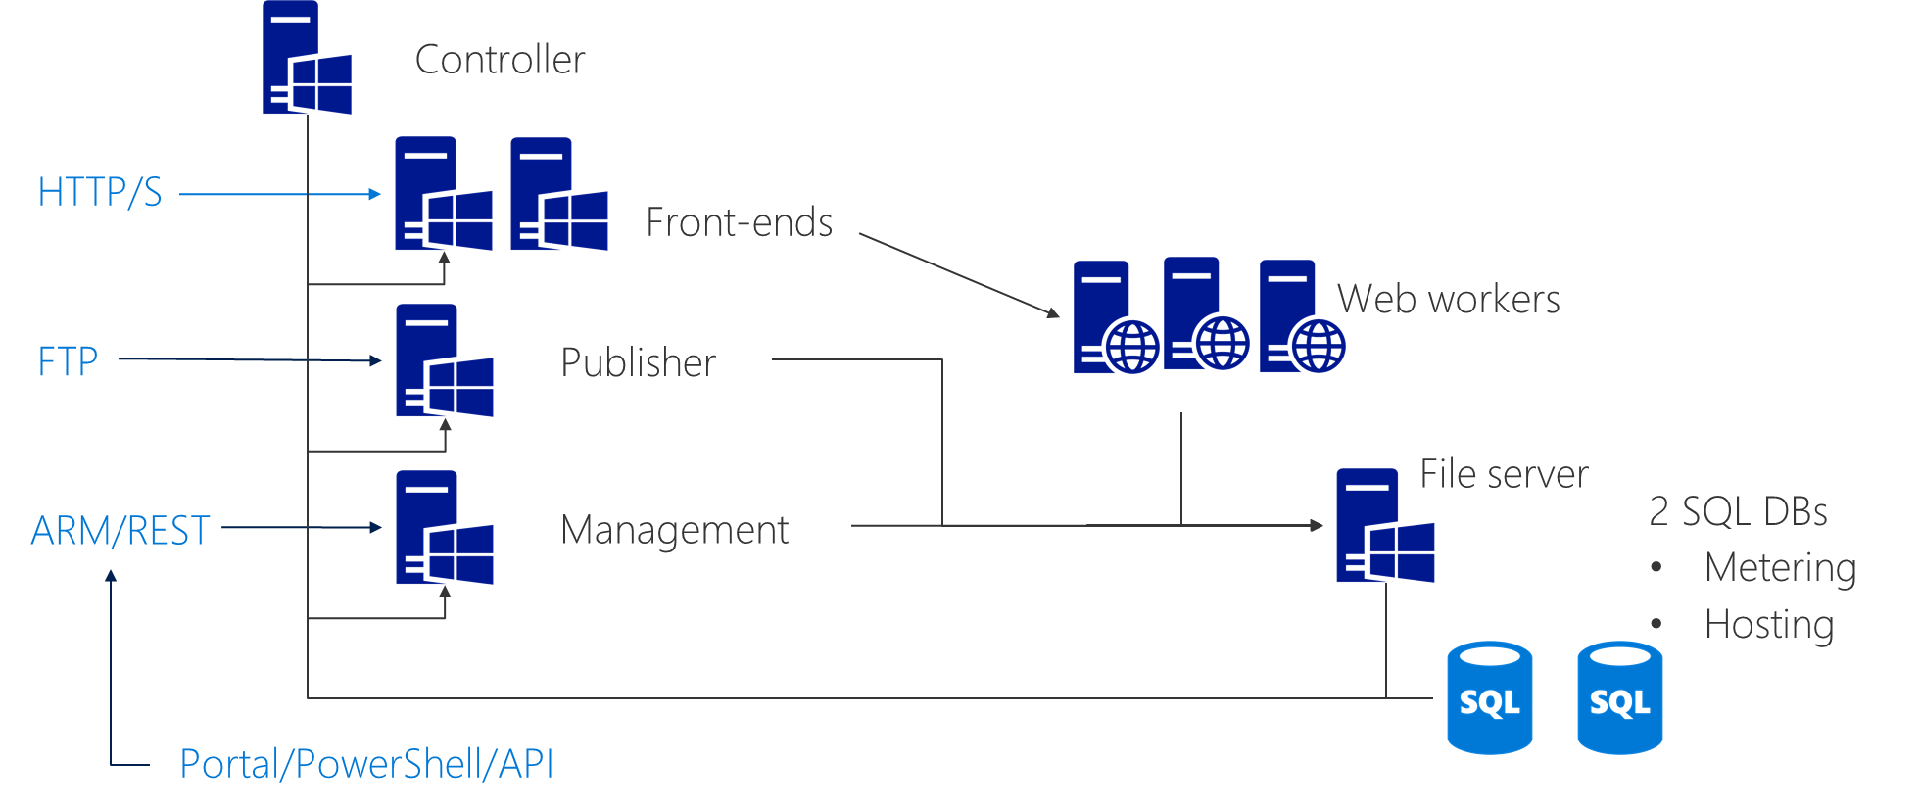
Architecture – App Service components
Controller
Manages App Service on Azure Stack Hub cloud
File Server
Application content
Management
API, UI Extensions, and Data Service
Front-end
App Service routing
Publisher
FTP, Web deploy
Web Worker(s)
Application host

Slide 16
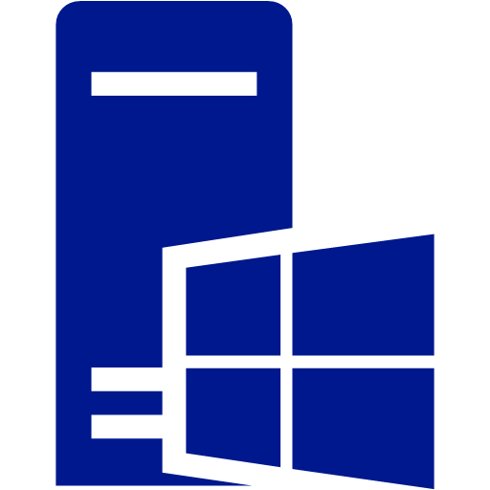

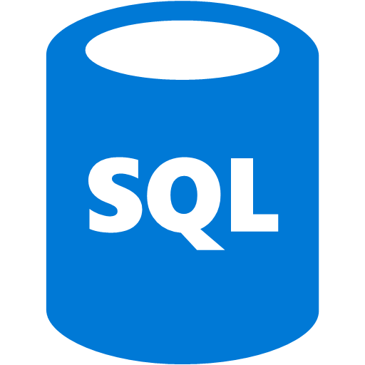
Architecture – Default deployment
Controller
HTTP/S
Front-ends
Web workers
Can be H/A File Server. You deploy it!
FTP
Publisher
File server
ARM/REST
Management
2 SQL DBs
Metering
Hosting
Portal/PowerShell/API
You cannot use the SQL RP for these databases…

Slide 17
Architecture: Site creation flow
Tenant creates site via Azure Stack Hub portal
ARM request is made
Request is forwarded to the App Service Resource Provider API on the management role
Management role receives request
Creates site in Hosting database
Creates content directory in File Server
Controller
HTTP/S
Front-ends
Web workers
FTP
Publisher
File server
ARM/REST
Management
2 SQL DBs
Metering
Hosting
Portal/PowerShell/API

Slide 18
Architecture: Publish site content
Customer starts to publish content to site via FTP
Publisher receives connection
FTP extension looks up the site’s home path from the Hosting database
FTP session established
User proceeds to upload content to their site’s home path
Controller
HTTP/S
Front-ends
Web workers
FTP
Publisher
File server
ARM/REST
Management
2 SQL DBs
Metering
Hosting
Portal/PowerShell/API

Slide 19
Architecture: First request
User makes request to the website/app
Front-end receives request
Contacts the data service on the Management Role
Data Service retrieves details from Hosting DB and allocates the workers to the site if required
Front-end can now route traffic to correct Web Worker(s)
Web Worker serves the request
Controller
HTTP/S
Front-ends
Web workers
FTP
Publisher
File server
ARM/REST
Management
2 SQL DBs
Metering
Hosting
Portal/PowerShell/API

Slide 20
Administration Scenarios

Slide 21
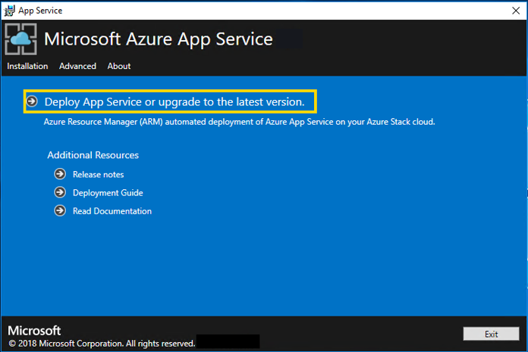
Deployment – Evolution
Improved based on customer feedback
Helper scripts
Easy-to-use installer
https://docs.microsoft.com/en-us/azure/azure-stack/azure-stack-app-service-deploy

Slide 22
Monitor and troubleshoot deployment
App Service installer
Resource Group deployment view
Azure Stack Hub logs
For example ScriptHostExtension Logs
Path on each VM is:
C:\Packages\Plugins\Microsoft.Compute.CustomScriptExtension\1.8\Status\0.status

Slide 23
Monitor and troubleshoot deployment
App Service Resource Provider Administration
Role logs
Web Cloud Management Console on controller
Another view on logs
Event logs on each role
Applications and Services Logs>Microsoft>Windows>WebSites

Slide 24
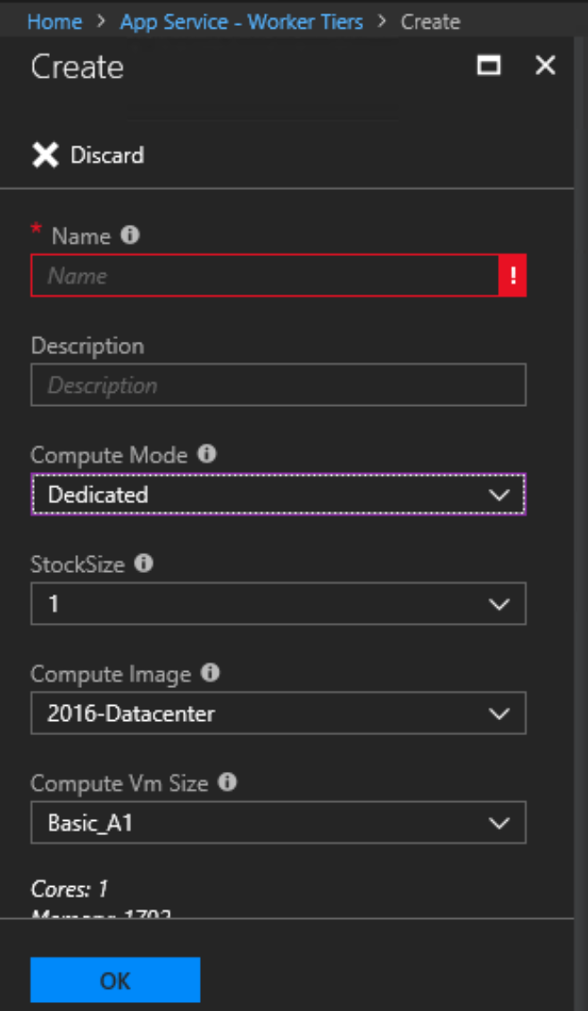
Custom worker tiers
Custom worker tiers give administrators ability to deploy custom workloads
Way of differentiating offering
Deploy internal assemblies
Deploy non-core application stacks, e.g. Go; Ruby
Deploy components not shipped in box, e.g. Oracle Clients

Slide 25
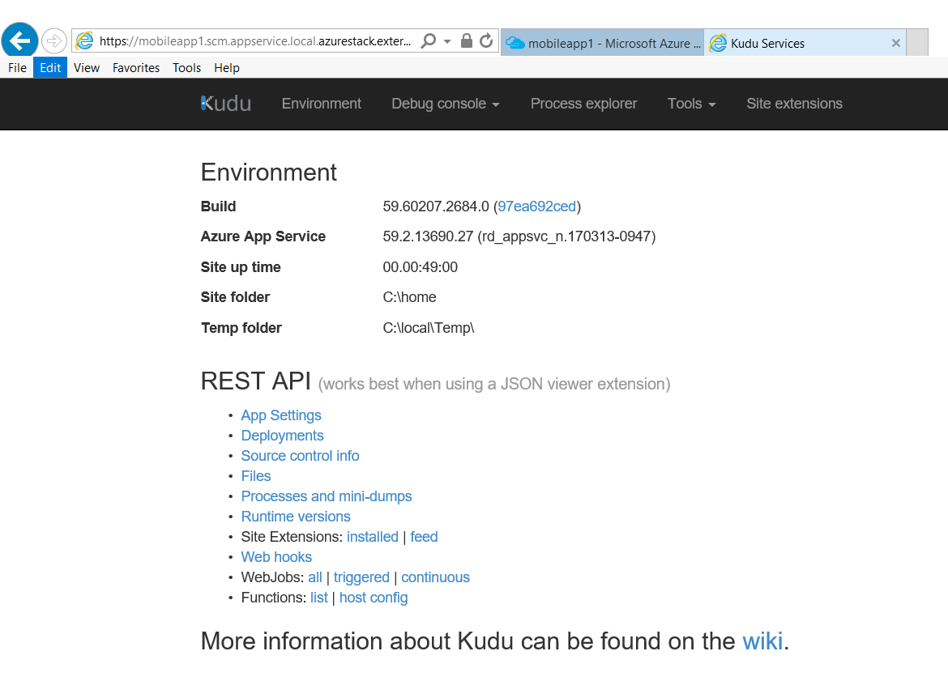
Kudu – Tools for developers
Built-in debug and troubleshooting tools for tenants
https://mysite.scm.appservice.<regionname>.<customerdomain>

Slide 26
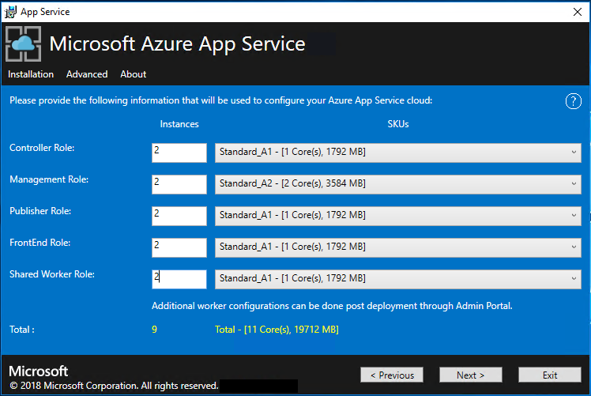
Sizing your App Service
Administrators can define the number and size of the VMs for each role
Use this screen to differentiate between various levels of App Service performance (shared workers)
Define instances and Server VM SKUs to use for shared workers and infrastructure roles
Dedicated workers can be adjusted using configuration of worker tiers and SKUs – see https://docs.microsoft.com/en-us/azure/azure-stack/azure-stack-app-service-capacity-planning

Slide 27
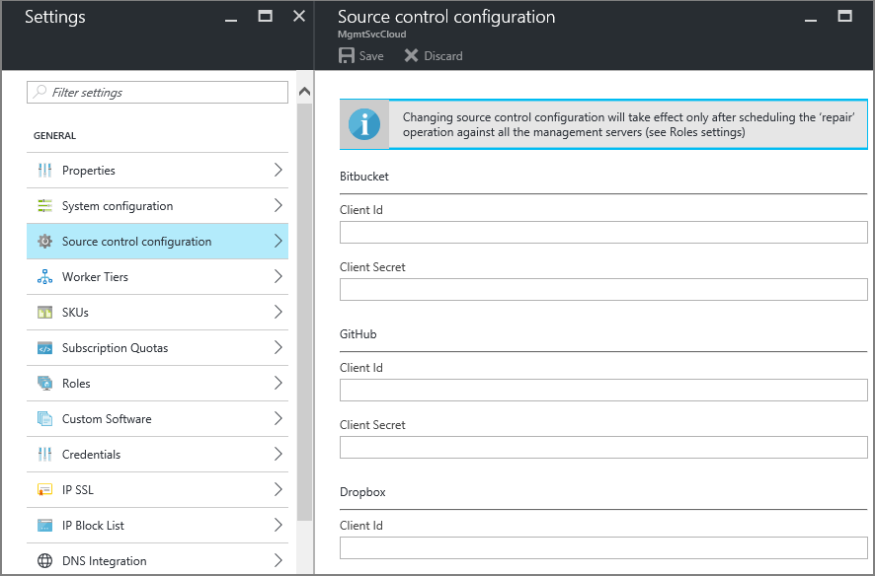
Configuring deployment sources
Support for deployment or continuous deployment from:
GitHub
BitBucket
Dropbox
OneDrive
Local Git
External repositories
Configure via PowerShell
Configure via Administration Portal

Slide 28
High availability
Azure App Service on Azure Stack Hub automatically deploys the App Service infrastructure across multiple fault domains
https://docs.microsoft.com/en-us/azure/azure-stack/azure-stack-app-service-before-you-get-started#high-availability
Guidance
Deploy multiple instances of roles for resilience and performance
Maximum two controllers
Multiple for other roles – see https://docs.microsoft.com/en-us/azure/azure-stack/azure-stack-app-service-capacity-planning
Make use of existing infrastructure if already in place
SQL Server cluster
File server (Standalone, Clustered, SOFS, NAS, Storage Space Direct, and NAS Devices)

Slide 29
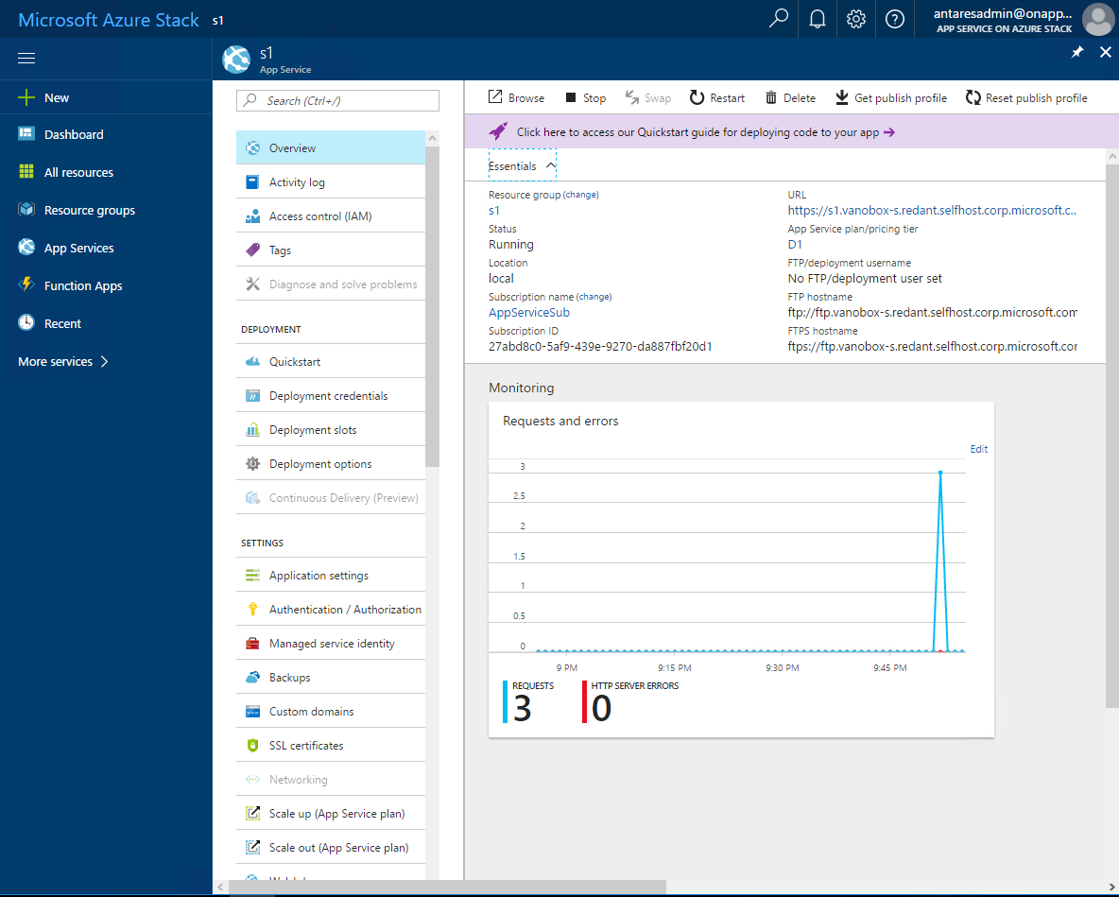
User view
Resource management and monitoring

Slide 30
Tooling consistency
Visual Studio
Publish to App Service (both Azure and Azure Stack Hub)
Cloud Explorer
PowerShell
CLI
Kudu
Kudu is the tool that can be used to automatically deploy websites to Azure or Azure Stack Hub from a repository like GIT
It’s a Microsoft-led open-source project
It also allows you to do typical web application status and troubleshooting tasks

Slide 31
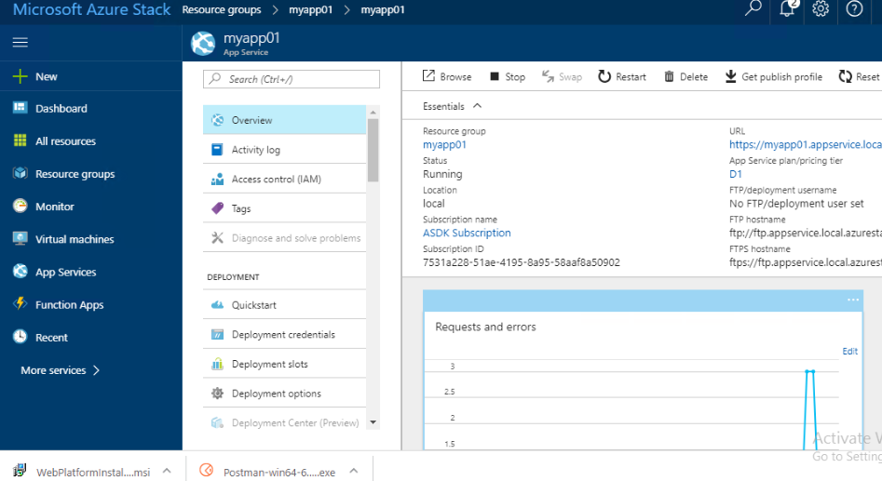
Connecting Visual Studio to Azure Stack Hub

Slide 32
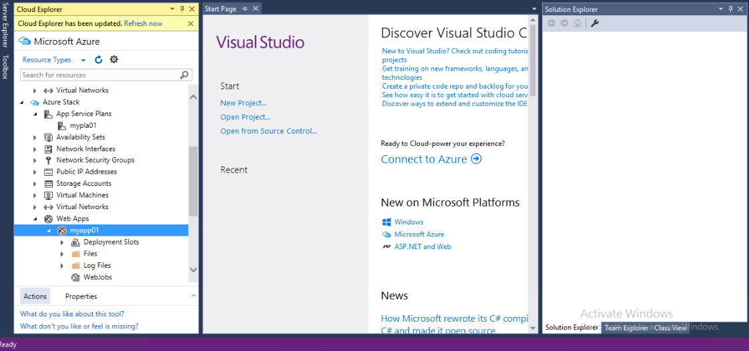
Connecting Visual Studio to Azure Stack Hub

Slide 33
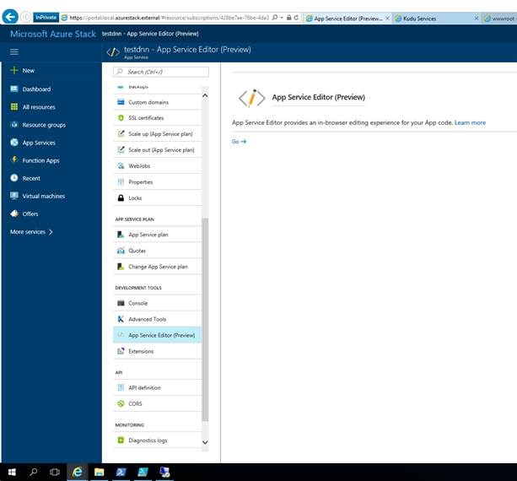
Integrated Developer Experience
Built-in in-browser code editor
“Kudu”
https://<sitename>.scm.appservice.<region>.<customerdomain>/
for example
https://testapp.scm.appservice.local.azurestack.external/
App Service Editor
https://<sitename>.scm.appservice.<region>.<customerdomain>/dev
for example
https://testapp.scm.appservice.local.azurestack.external/dev
NB: both accessible from within the tenant portal

Slide 34
Integrated tenant administrative experience with Kudu
Built-in debug and troubleshooting tools for tenants
https://mysite.scm.appservice.<region>.<customerdomain>

Slide 35
Questions?

Slide 37
Appendix

Slide 38
Examples of issues experienced
Deployment failures
Unable to create VMs
Functions portal doesn’t load
Has the admin completed the SSO tasks? Read through the release notes for any specific post installation steps needed.
Tenant apps unable to connect to SQL / MySQL
Connection string is incorrect

Slide 39
Adding capacity to App Service on Azure Stack Hub
First task after deployment for most
Multiple ways to add more capacity
Deploy template of VMs and add to App Service Cloud
Add additional workers using Administration Experience (maximum of 10* per run)
Controller deploys required runtimes and marks workers as ready
Improved for GA with using VMSS

